Slide 1
24: The Future of AI, ML, Robotics
CSCI 561 Foundation for Artificial Intelligence
Professor Wei-Min Shen
University of Southern California

Slide 2
Outline
Predicting or shaping the future?
Robotics (see the handout slides)
Autonomous Learning from the environment

Slide 3
Future of AI, ML, Robotics
The Future of Artificial Intelligence
From DeepBlue to AlphaGo
From Roomba to UAVs and Swarm Robots
From autocoups learning and self-reconfigurable robots to soft-robots
!!!!!
Quotes from the Pioneers of AI and ML
Professor Herbert A. Simon

Slide 4

Forecasting the Future or Shaping It?
October 19, 2000
Our task is not to predict the future; our task is to design a future for a sustainable and acceptable world, and then to devote our efforts to bringing that future about.
Professor Herbert A. Simon
Nobel Prize Laureate
A Founder of Artificial Intelligence

Slide 5
A Sustainable and Acceptable World! --- Herbert A. Simon, 2000
We must find a way for living at peace with all of nature, not destroying the bases for the survival of all of us
We must find a way for sharing broadly and fairly the outputs of our productive efforts of all kinds, no matter how ample or limited these outputs are in a sustainable world
We must, as a necessary condition for maintaining any standard of fairness, find some way of greatly mitigating, and if possible eliminating, the innumerable and passionate divisions of "we" from "they" that continue to make the human world a blood-stained collection of warring tribes, continually engaging in fluctuating patterns of mutual hostility and collective mayhem, of which traditional war is only one of the more obvious forms, perhaps not even the one most devastating or difficult to root out

Slide 6
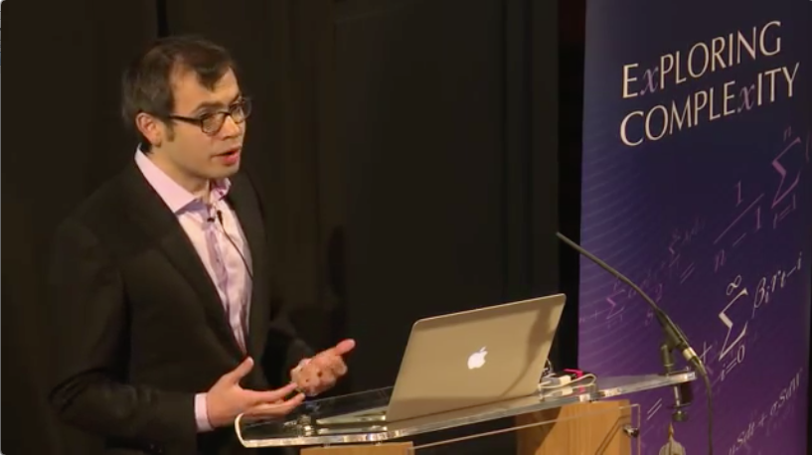
Future of Artificial Intelligence by Dr. Demis Hassabis (2017)

Slide 7



Agent, Environment, No States
Sensors
No state information
Agent
percepts
Environment
Intelligence
Agent
actions
Effectors

Slide 8
Autonomous Incremental Structure Learning from the Environment
Type I: Clustering the data
Automatically group the data into clusters
Type II: Parameter Learning (states are known)
Learn transitions, sensor models, & current state
Type III: Structural non-parametric Learning
States are not known and must be learned
States have internal structures (not just “symbols”)

Slide 9
Formation of General Problems
P(X_{1:t}|E_{1:t})
compare all state sequences I might go through (”explanation”)
P(X_{t}|E_{1:t})
which state I am in now (“state estimation” “localization”)
P(X_{t+k}|E_{1:t})
which state I will be in at time t+k (“prediction”)
P(X_{k}|E_{1:t})
which state I was in at time k (k<t) (“smoothing”)
P(x_{1:t}|E_{1:t})
what is the best state sequence that I went through (”viterbi”)
P(M_{t}|E_{1:t}) // when states are known
How correct is my model at time t (“model learning”)
P(M_{t}|E_{1:t}) // when states are not known
When states are not known, how can we construct and abstract a correct model from the experience in an environment?

Slide 10
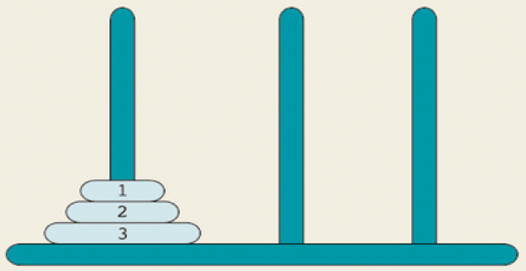
Example: Solving Tower of Hanoi without knowing the rules
See details in the ALFE book

Slide 11


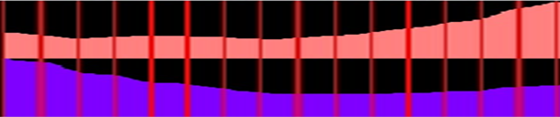
Recognizing Actions from Videos
Model Learning
Sample the data stream at fixed intervals, e.g. 10 frames
Learn a prediction model by observing data before and after each segment
Group prediction rules that fire together into a state
Extract the sequence of states (prediction sequence) for each example
Store state transition probabilities for positive examples in a Markov chain
rules learned for “replace”
SBL
Rule 0 - 1 : 0.9 [ (REL 0 % 0) ^ (REL 1 S < 60) ] [Action = 1] [((REL 0 S = 50) OR (REL 1 S != 60) OR (REL 1 ~ 0))]
Rule 1 - 0 : 1 [ (REL 0 % 0) ^ NOT { (REL 1 S < 60) } ] [Action = 1] [((REL 0 S != 50) OR (REL 0 ~ 0)) AND ((REL 1 S ^ 5))]
Rule 2 - 3 : 0.9 [ (REL 1 % 0) ^ (REL 1 S > 60) ] [Action = 1] [((REL 1 S v 5) OR (REL 1 S != 60) OR (REL 1 ~ 0))]
Rule 3 - 1 : 1 [ (REL 1 % 0) ^ NOT { (REL 1 S > 60) } ] [Action = 1] [((REL 1 S ^= 5) OR (REL 1 ~ 0)) AND ((REL 1 S = 60))]
{R0,R2}
1/8
{R1,R3}
7/8
7/7
{R0,R2}
{R0,R2}
{R0,R2}
{R0,R2}
{R0,R2}
{R0,R2}
{R0,R2}
{R1,R3}
{R1,R3}
{R1,R3}
{R1,R3}
{R1,R3}
{R1,R3}
{R1,R3}
{R1,R3}

Slide 12
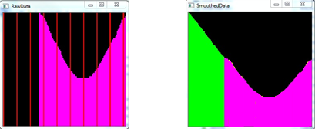
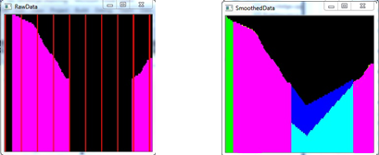
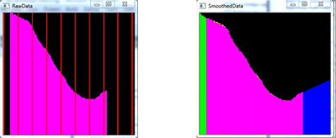
Example: Filling the Gaps in Data
Perform BFS with the Markov Chain to fill gaps
Beginning – Post diction from first known state
Middle - Interpolation between known states
End - Prediction from the last known state
Does not recover each trend, recovers state
Slight penalties applied to decrease the likelihood action detection

Slide 13
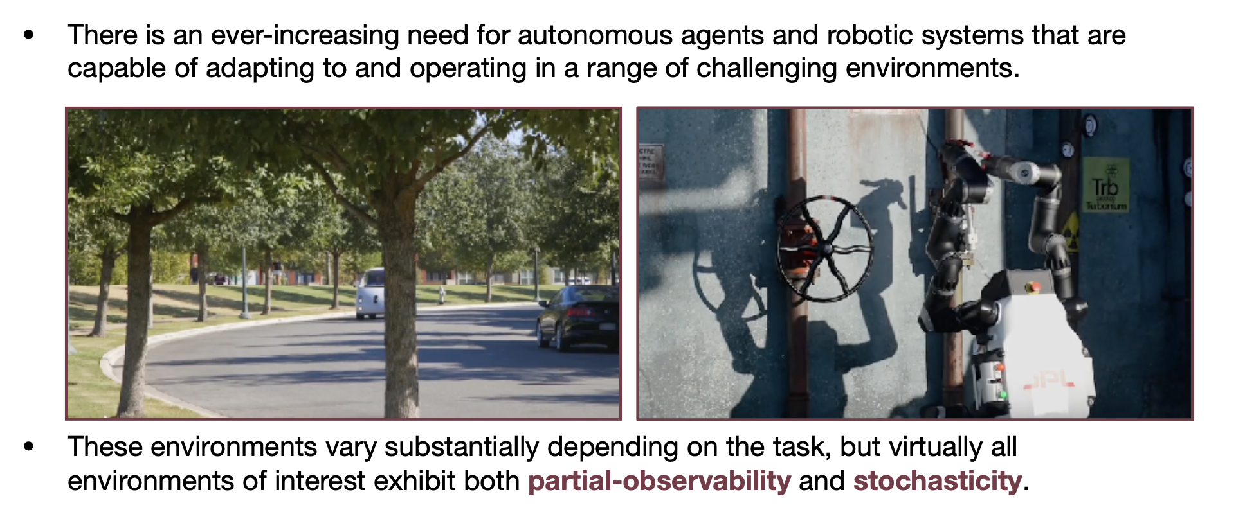
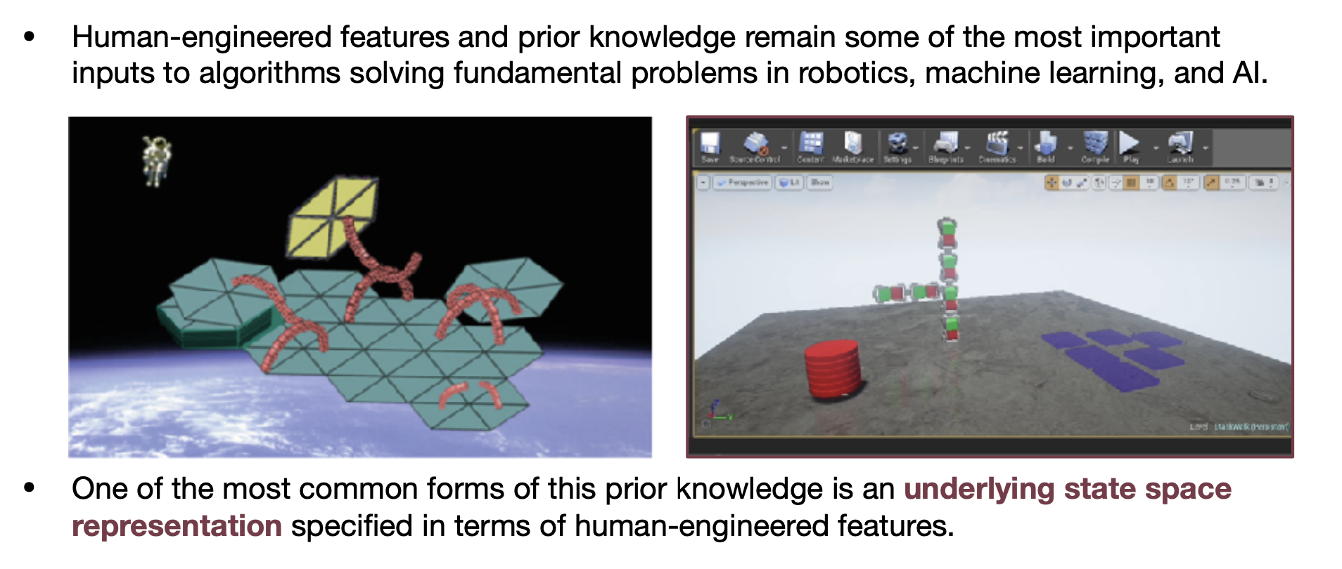
Adapting to New Environments

Slide 14
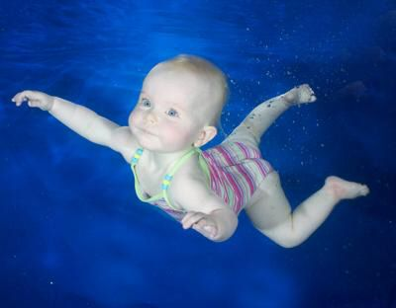
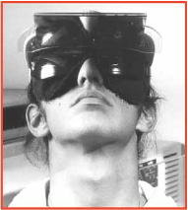
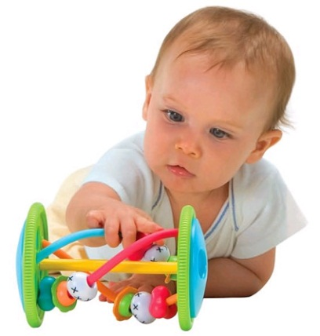
Other Famous Examples
New Environment/Task ⇔ Learning ⇔ Knowledge/Skill
Key Idea: To detect and learn from the experiences
Adaptive to new environments (may have no priori knowledge, “swim”)
Learn to accomplish new tasks (goals may change dynamically)
Self-heal from unexpected failures or dynamics (e.g., inverted visions)

Slide 15
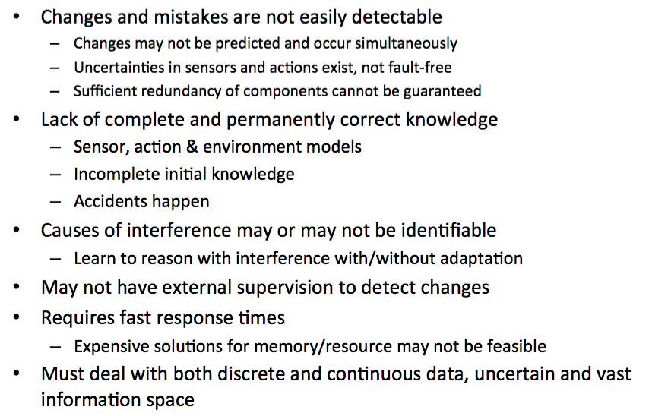
Technical Challenges (why hard?)

Slide 16
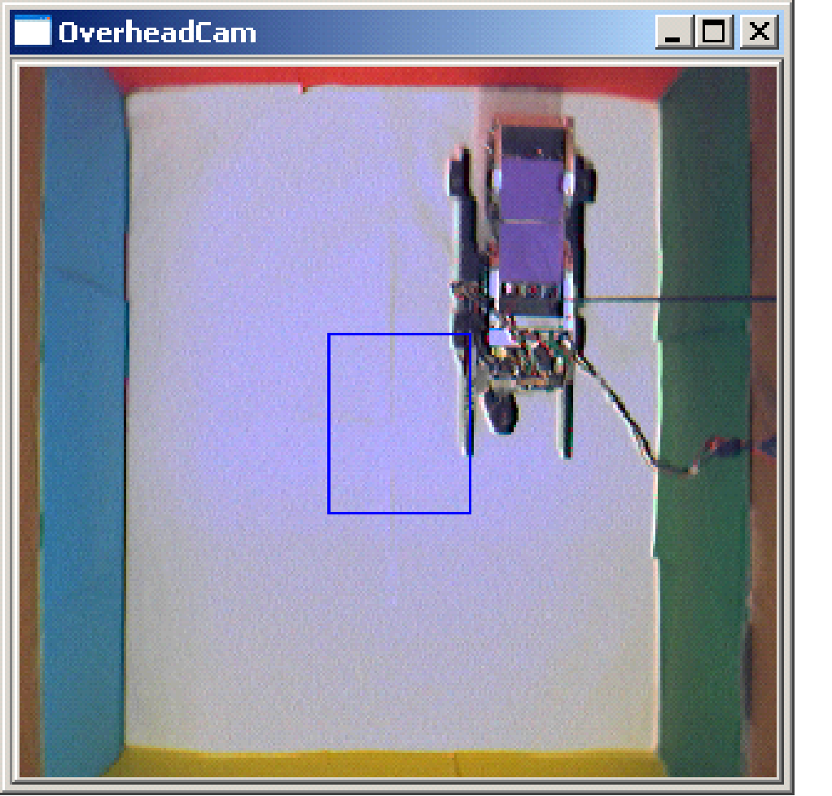
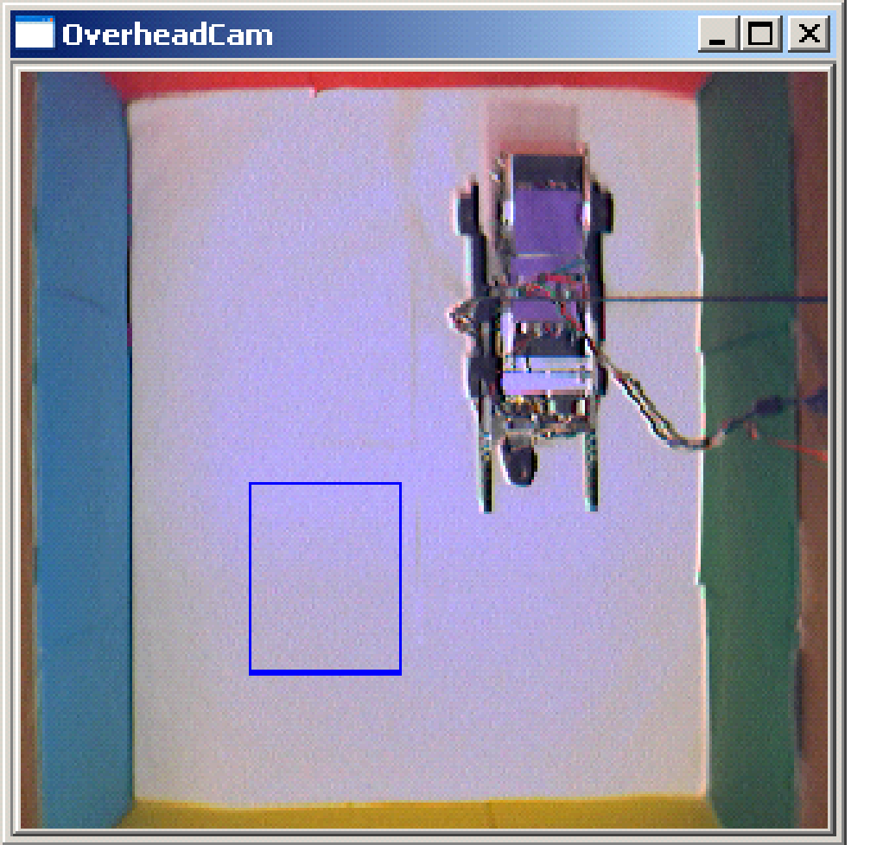
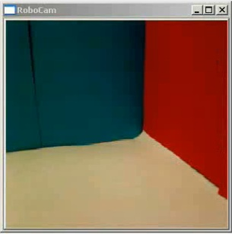
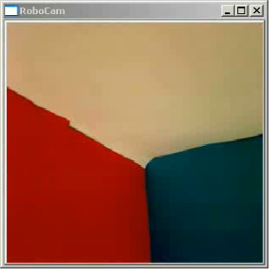
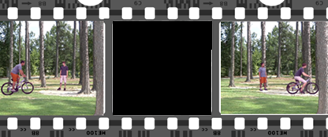
Deal with Unpredicted Changes
Uninformed changes to the robot at runtime
Sensors: addition, deletion, definition-change, interference
Actions: addition, deletion, definition-change, interference
Goals: addition, deletion
Dynamic configurations of the environment
Objects: addition, deletion, relocation
“Definition-change” alters mapping of input to output
Rotation, Translation, Scale
Interference includes noise & missing data or gaps
Goal change
Rotated camera
Gap
Notes:
Examples: Camera accidentally rotated, Cross-wire causing actions to toggle, Goal change based on needs such as charging, Another agent moved an object, Occlusions causing gaps

Slide 17
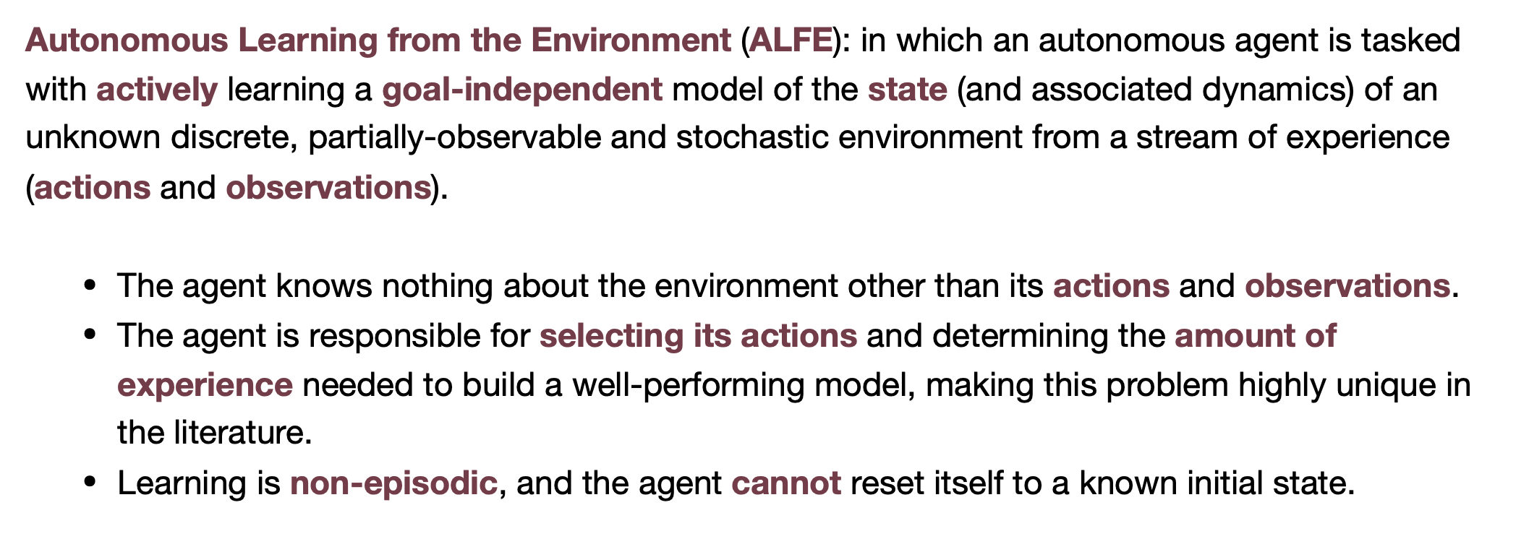
Problem Statements

Slide 18
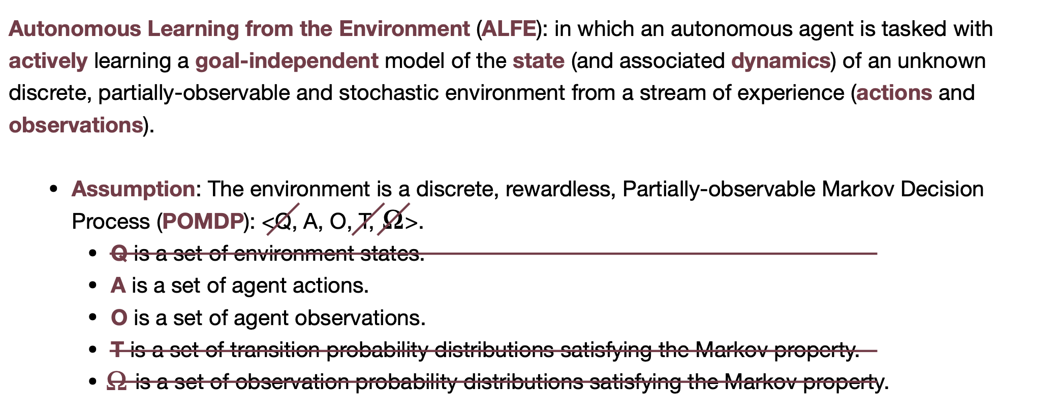
Key Assumptions

Slide 19
Key Challenges
Partial-observability
How much history does the agent need to consider?
Stochasticity
What is noise and what is surprising?
Minimal prior knowledge
How many parameters should the agent’s model have?
Action selection
How to choose actions with no explicit rewards?
State space formalization
How can a model built in terms of action/observation sequences be used as a state space?
Decision making
How can the agent use this model to make decisions that allow it to achieve goals?

Slide 20
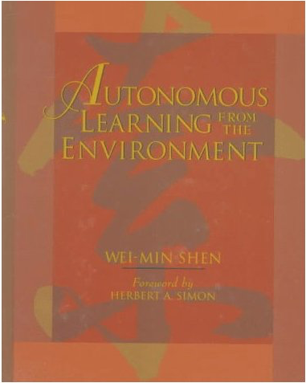
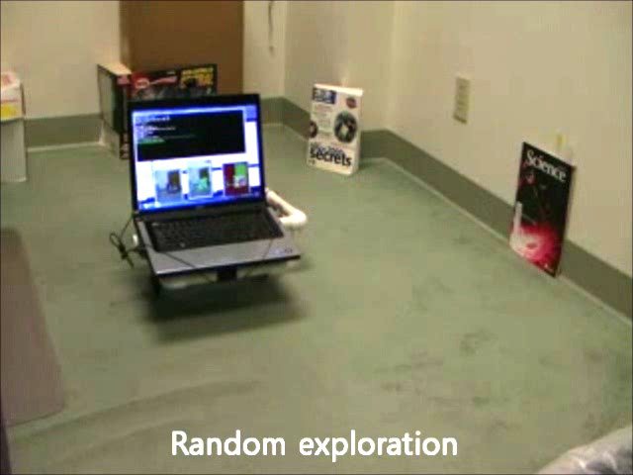
Surprise-Based Learning (CDL++)
Perception
observation
Surprise
Analyzer
prediction
Predictor
TASK/ENVIRONMENT
(BLACK BOX)
Model Modifier
Model Synchronizer
Model
actions
Plan
Action Selector
(Planner)
Goals (Intensions)
The Learner continuously makes predictions, detects surprise, analyzes surprises, extracts critical information from surprises, and improves and use its action models
Surprise ==> Model ==> Prediction

Slide 21
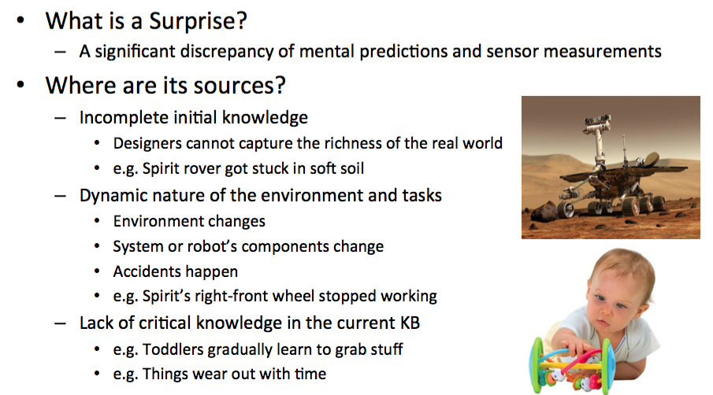
Surprises and Their Sources

Slide 22
Properties of Surprises
Types of surprise
Unexpected failures
Unexpected successes
Null prediction surprise
When there is no a priori model
Differentiate “new information” from noise
Focus attention on the relevant features
Seek differences that are statistically significant

Slide 23
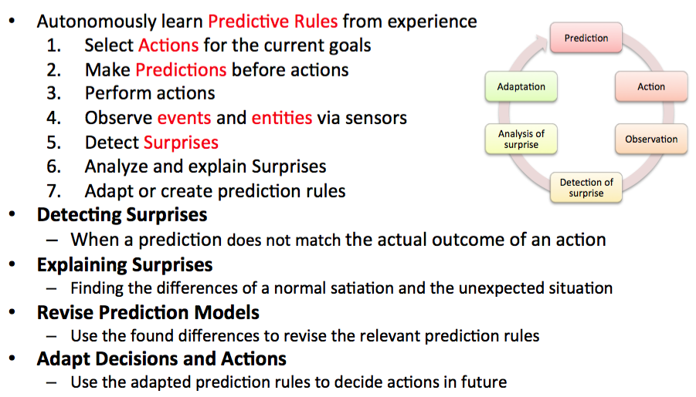
The Cycle of SBL (CDL++)

Slide 24
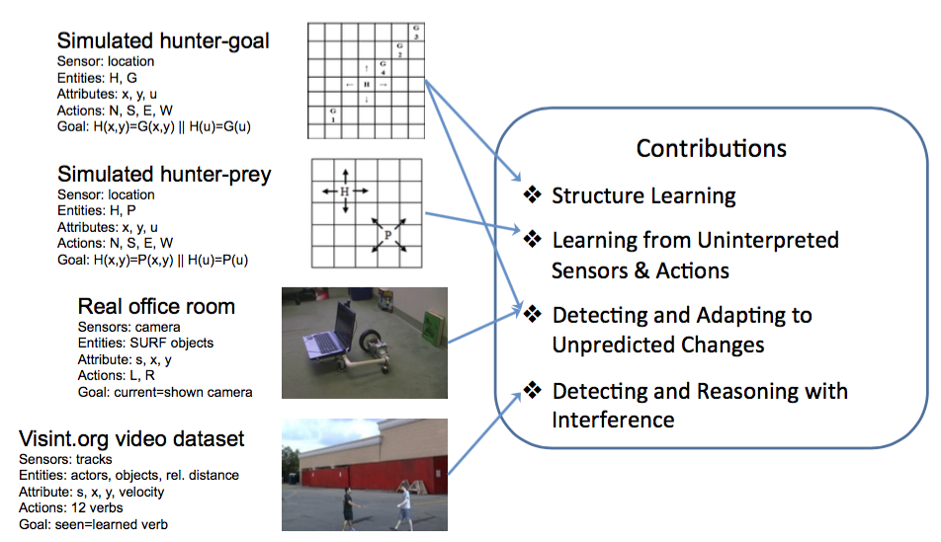
Example Environments/Tasks

Slide 25
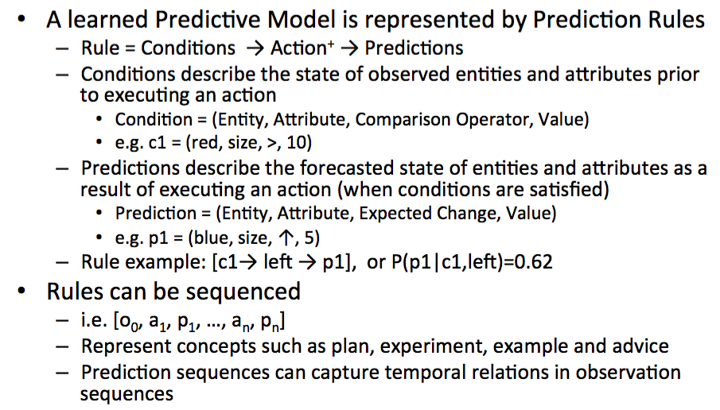
Prediction Rules and Models

Slide 26
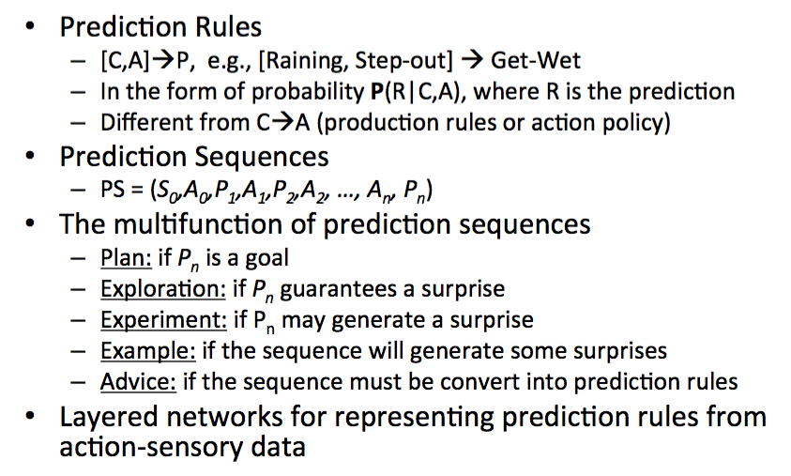
Model Representation

Slide 27
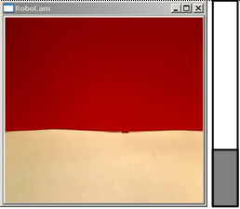
Components of Prediction Rule
Goals
G = {(s₁e₁b₁=v₁) ∧ (s₁e₁b₂=*) ∧ (s₂e₁b_{x}≠∅) ∧ … ∧ (s_{i}e_{j}b_{k} = v_{l})}
True when O_{t} ⊨ G
e.g. desired observation shown
Models
Observations
O_{t} = {(s₁e₁b₁=v₁) ∧ … ∧ (s_{n}e_{i}b_{j}=v_{k})}
Sensors
{s₁, s₂, … , s_{n}}
e.g. {proximity, camera, goal}
Actions
{a₁, a₂, … , a_{n}}
e.g. {F,B,L,R}
Comparison Operators
{%,~, ↑, ↓,◉₁, ◉₂, … , ◉_{n}}
e.g. {%,~,<,<=,=,!=,>=,>,↑,↓}
Entities
{e₁, … , e_{f}}
e.g. {blob_white, blob_red etc.}
Attributes
{b₁, … , b_{g}}
e.g. {size, center-x, center-y}
Predictions
Prediction for t is a forecasted observation in CNF prior to t
P_{t} = {(s₁e₁b₁◉v₁) ∧ … ∧ ¬(s₂e₁b₁◉v_{k})}
True when O_{t} ⊨ P_{t}
Surprises
A discrepancy between a prediction and its observation at t
True when O_{t} ⊭ P_{t}
Values
continuous [p, q] or discrete {v₁, v₂, … , v_{h}}
Notes:
A surprise is true when none of the predicted values in a clause are contained within the observation.
Assumptions: 1) No hidden states 2) Sensor, Entity, Attribute relations, Comparison operators pre defined 3) Continuity of entities 4) No or negligible interference during training

Slide 28
Analyzing and Using Surprises
Extract the critical information from a surprise
Create new model, if it is a null-prediction surprise
(~non-exists ^ exists) = action => (appeared ^ disappeared)
Improve the learned model
Compare the surprised situation with previous situations where the prediction was successful (i.e., “find the differences”)
Identify salient features that discriminate the situation
Which part of the memory to compare? (the effect of “first kiss”)
Finding the true cause of a surprise could be difficult
E.g., Raining days? Mondays?
Too many differences
Too few differences (no differences)

Slide 29
Desirable Features
Autonomously extracts the states and corresponding state machines from the training dataset object tracks
Number of states, observed features of states & transitions between states need not predetermined
Top-down approach to meet low-level measurements and evidences
Learn the structure of states for description and explanation of revisions
“Surprise” connects to “anomaly” and “unexpected interference”

Slide 30
Some Initial Results
Discrete or symbolic environments
Developmental learning to use novel tools
Scientific discovery of hidden features (genes)
Game playing
Learning from large knowledge bases
Robotics environments
Sensor recovery in office environment
Recognize/predict visual acDons from video
Detect abnormality in robot/UAV swarms

Slide 31
Life Cycle of a Predictive Rule/Model
BC
BR
SC
SR
a
a
time
t₁
t_{now} = t₂
possible causes of surprise
surprise
observations
surprise
R₀₀: c₀ ⋀ c_{x} –a⁺→ p₀ ⋁ ~p_{x}
Split Rule
R₀₁: c₀ ⋀ ~c_{x} –a⁺→ ~p₀ ⋀ p_{x}
R₀₀ : c₀ ⋀ c_{x} ⋀ c_{y} –a⁺→ p_{z}
Refine Rule
R₀₁ : c₀ ⋀ ~(c_{x} ⋀ c_{y}) –a⁺→ ~p_{z}
No Rule
Create Rule
R₀: c₀ –a⁺→ p₀
surprise
BC
BR
SC
SR
complementary
complementary
a
a
time
t_{now} = t₁
forget (reject)
Notes:
Compare the observations before and after an action was executed & create a rule for each difference.
Each cause or correlation is an expression of an entity or an attribute that was true in BC but false in SC. SBL assumes that a good cause can be found, no hidden states.
When split, one rule is specialized and the other is generalized in a complementary way.

Slide 32
Dealing with Unpredicted Changes
Goal change
Plan with the learned model to observable goals
Maintain a list of goal observations for hidden goals
Dynamic configurations in the environment
Forget obsolete rules through rule rejection when contradictions or the success probability of a rule drops below a cutoff
Action & sensor changes
Maintain a table with each row recording the relevance of a sensor, entity, attribute and action
Identify irrelevance by monitoring entities and attributes in the learned prediction rules
Force relevance when none of the active entities or attributes change

Slide 33
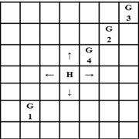
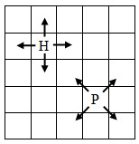
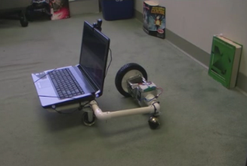
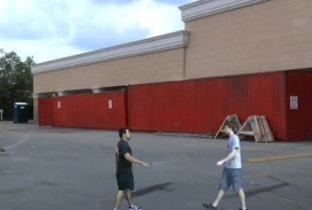
Some Evaluation Environments
Simulated hunter-goal
Sensor: location
Entities: H, G
Attributes: x, y, u
Actions: N, S, E, W
Goal: H(x,y)=G(x,y) || H(u)=G(u)
Contributions
Structure Learning
Learning from Uninterpreted Sensors & Actions
Detecting and Adapting to Unpredicted Changes
Detecting and Reasoning with Interference
Simulated hunter-prey
Sensor: location
Entities: H, P
Attributes: x, y, u
Actions: N, S, E, W
Goal: H(x,y)=P(x,y) || H(u)=P(u)
Real office room
Sensors: camera
Entities: SURF objects
Attribute: s, x, y
Actions: L, R
Goal: current=shown camera
Visint.org video dataset
Sensors: tracks
Entities: actors, objects, rel. distance
Attribute: s, x, y, velocity
Actions: 12 verbs
Goal: seen=learned verb
Notes:
Randomize axis labels for hunter-prey for learning from uninterpreted sensor and actions

Slide 34
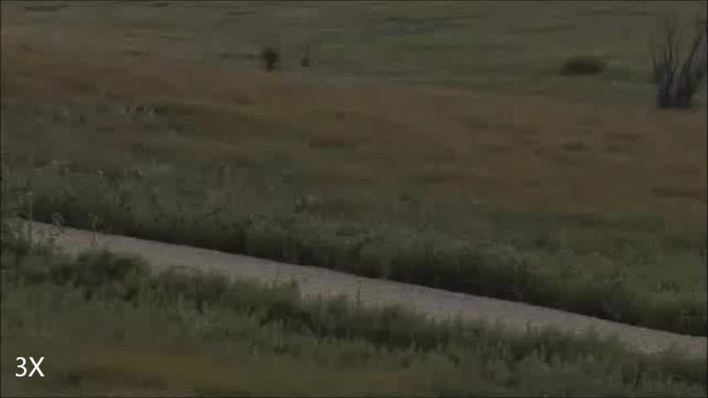
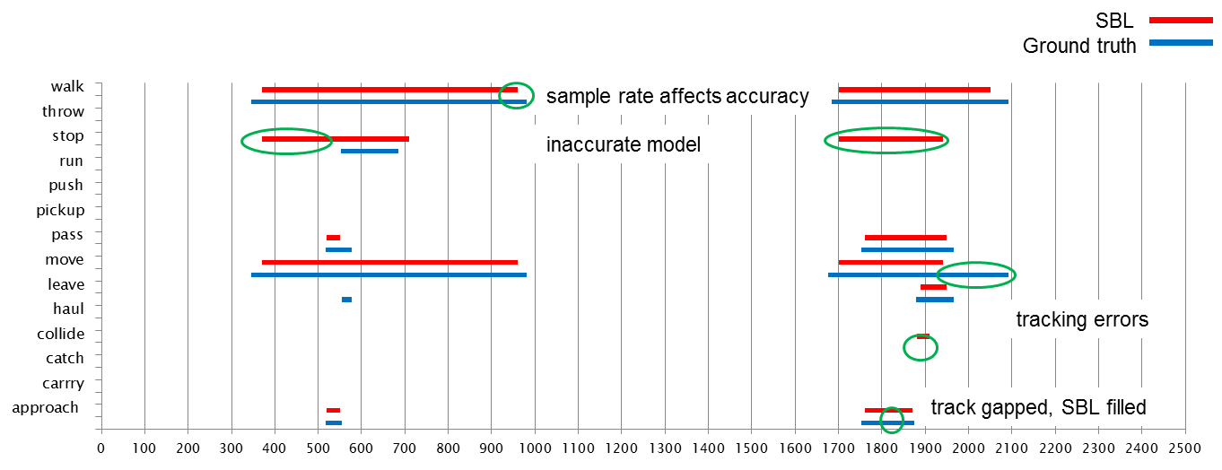
Recognition Example

Slide 35
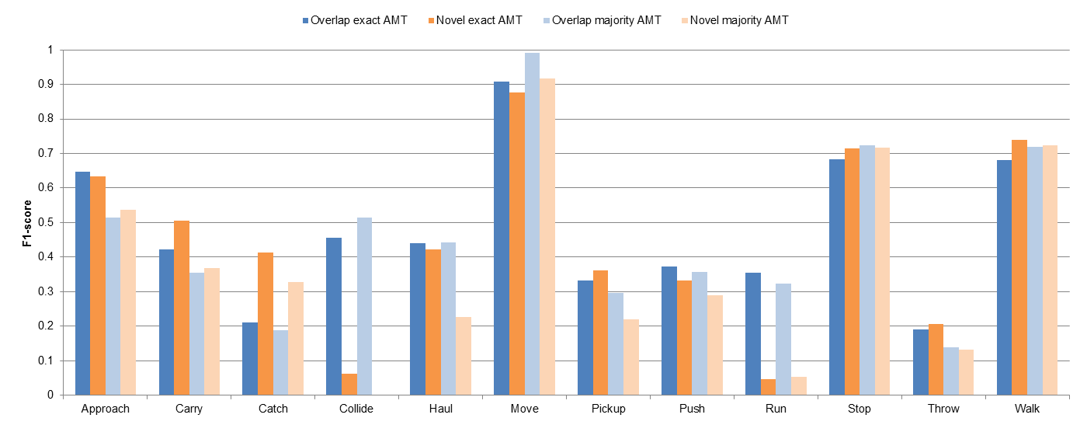
Recognition Results
Visint.org Year 1 Dataset, USC tracks, 1200 videos
F1 = (2*precision*recall)/(precision+recall)
Outperformed hand-coded SAM by more than 10%
Reasoning with detector accuracies below 20%

Slide 36
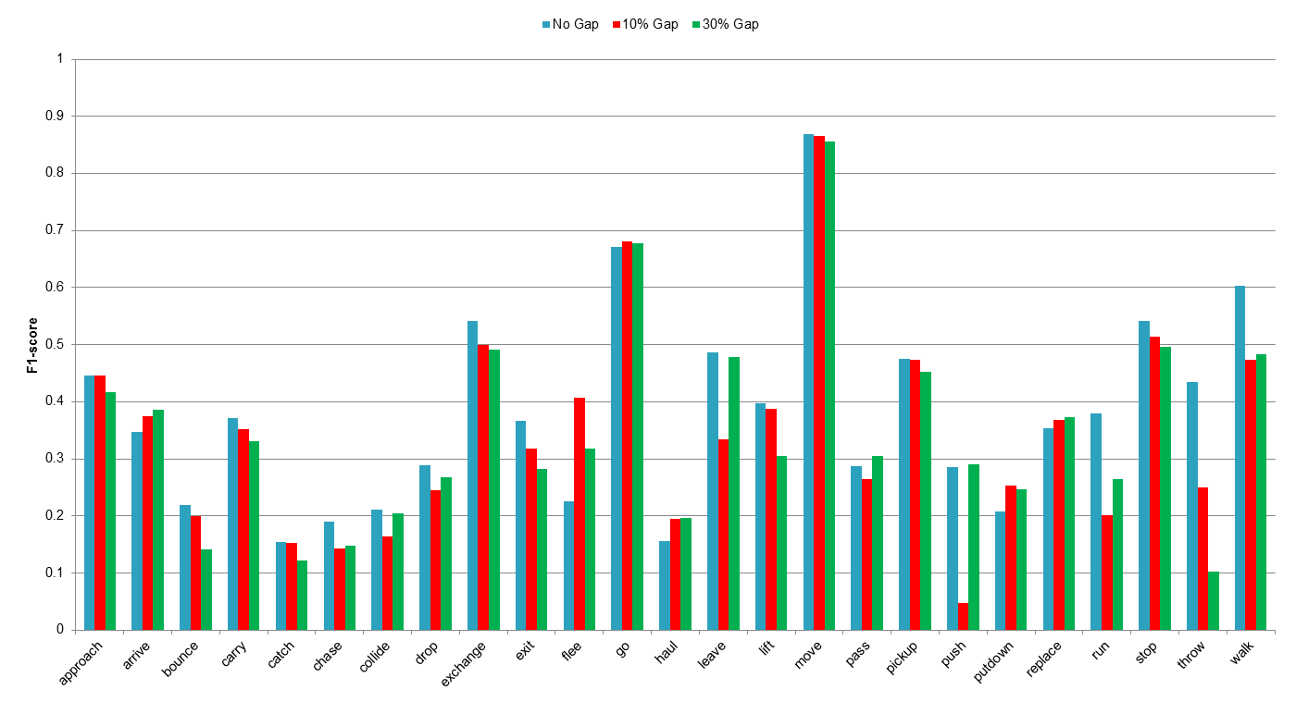
Gap Filling Results
Synthetic gaps introduced into 700 annotated videos

Slide 37
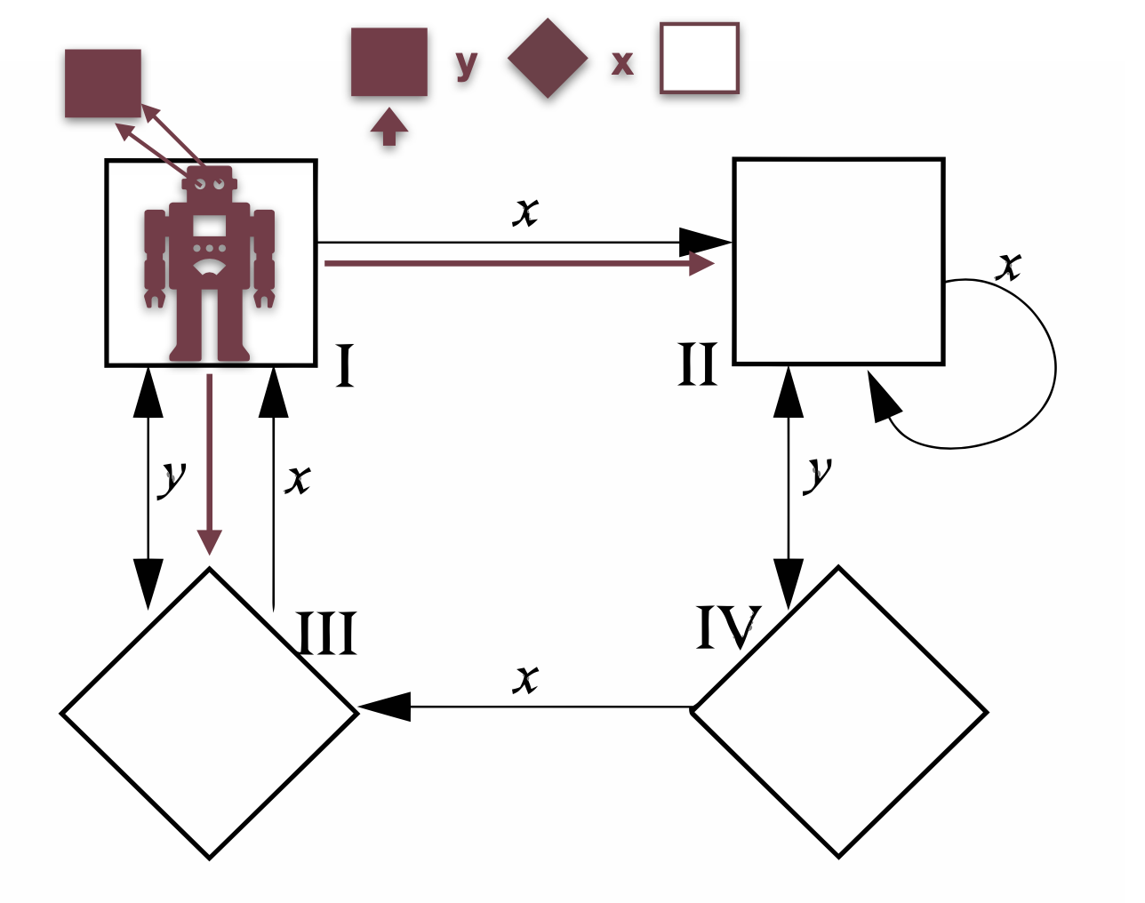
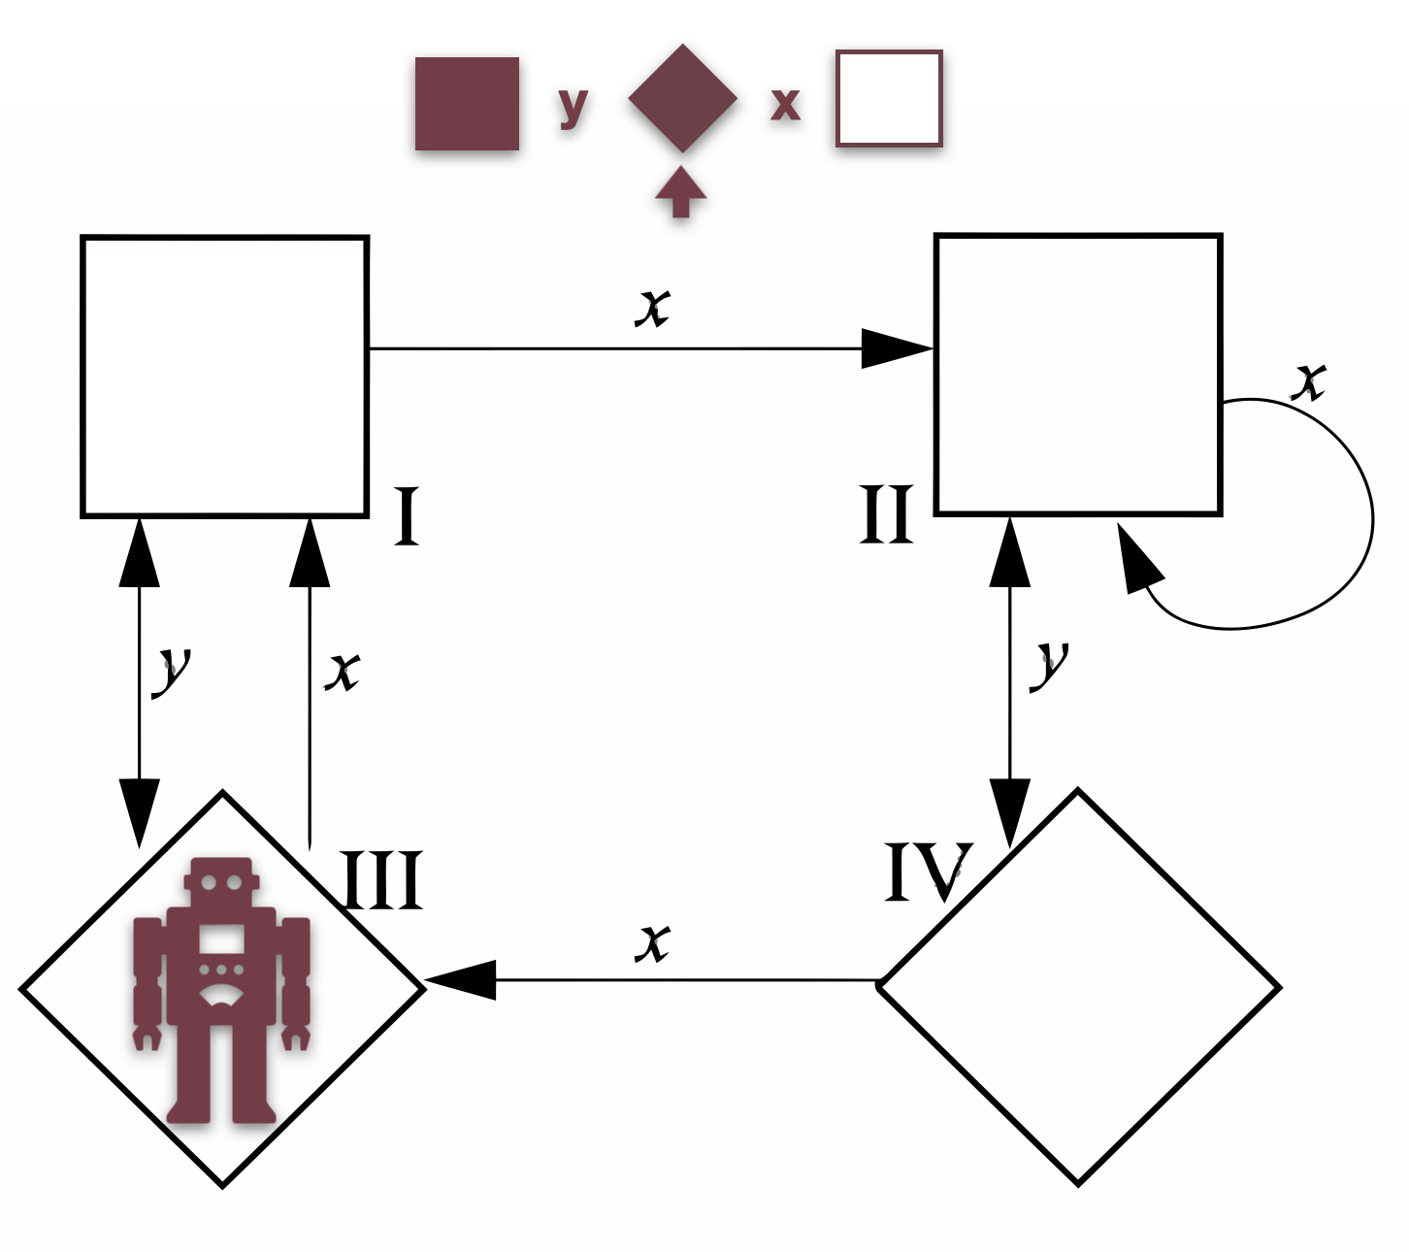
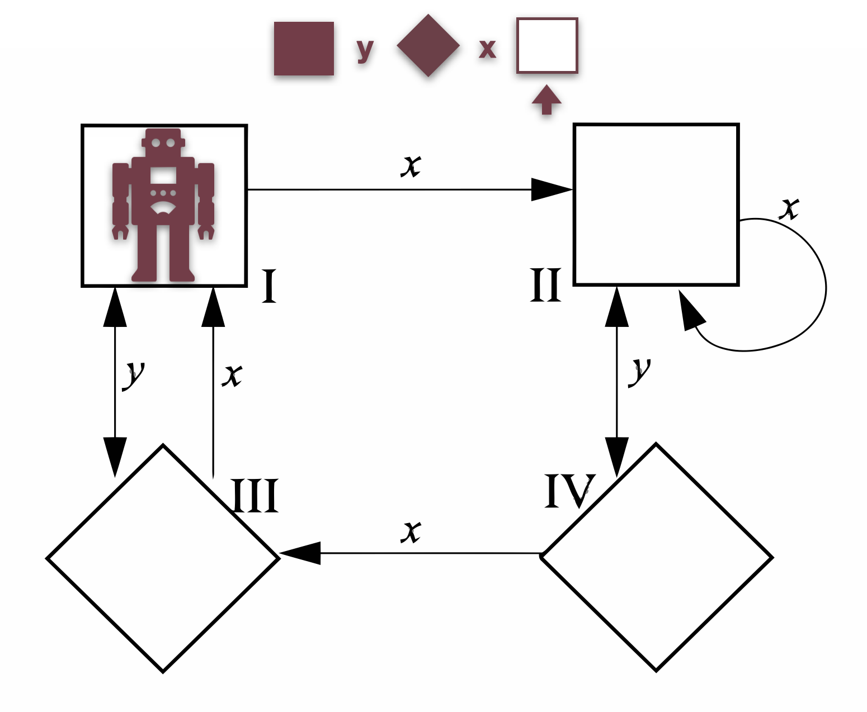
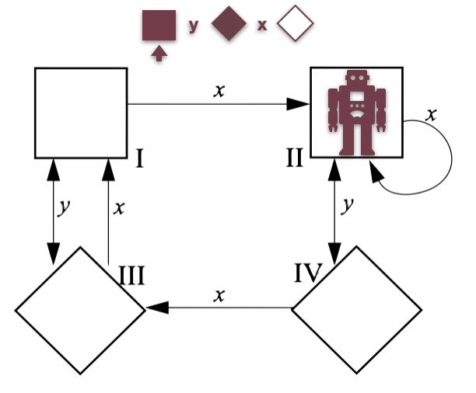
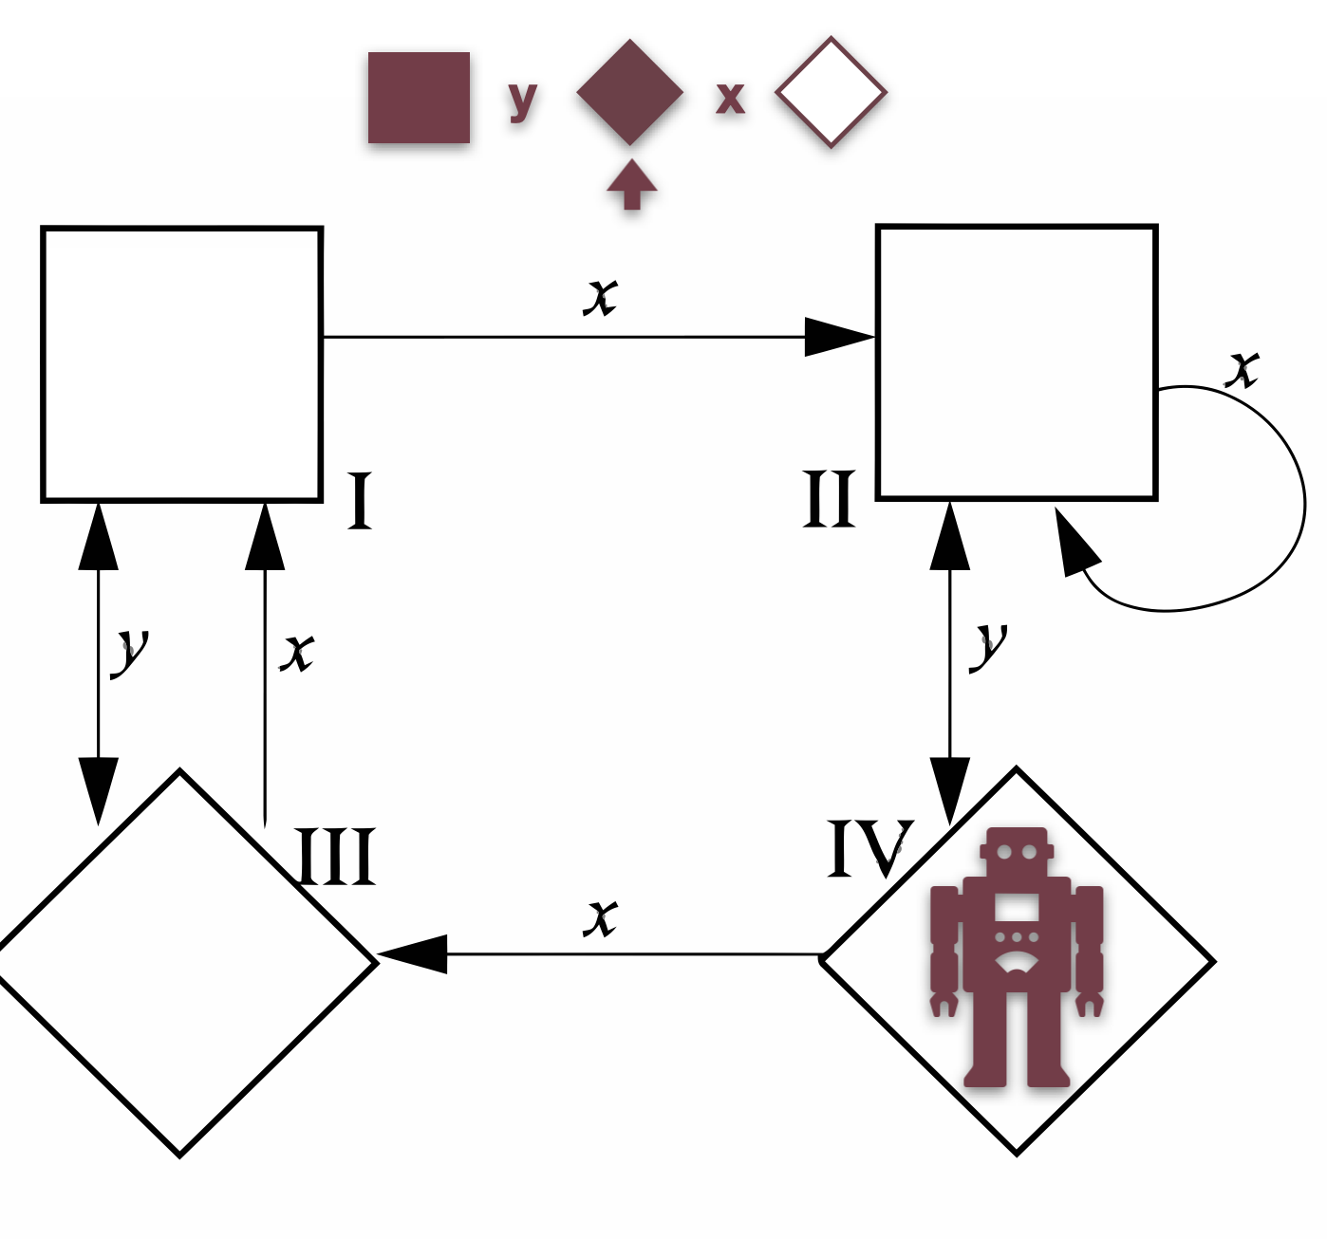
Stochastic Distinguishing Experiments - TJ Collins and WM Shen, 2018
?
Predict [], but see <>
A surprise!

Slide 38
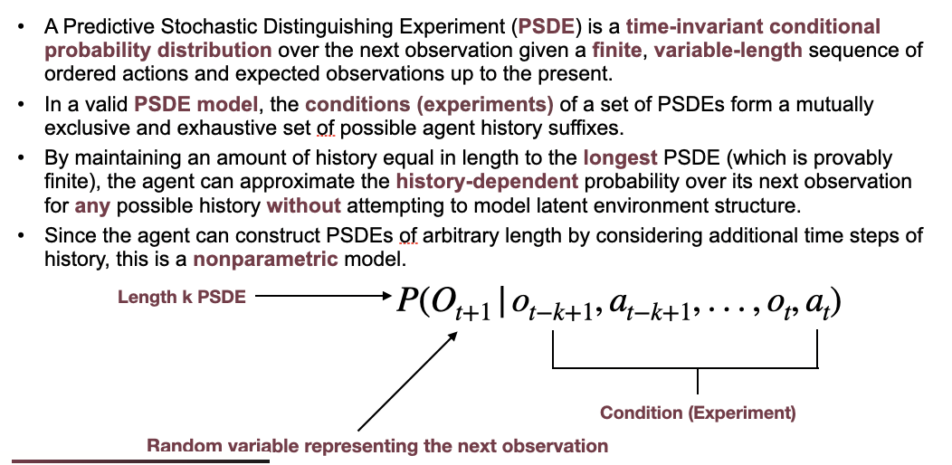
Prediction -- Formal Definition

Slide 39
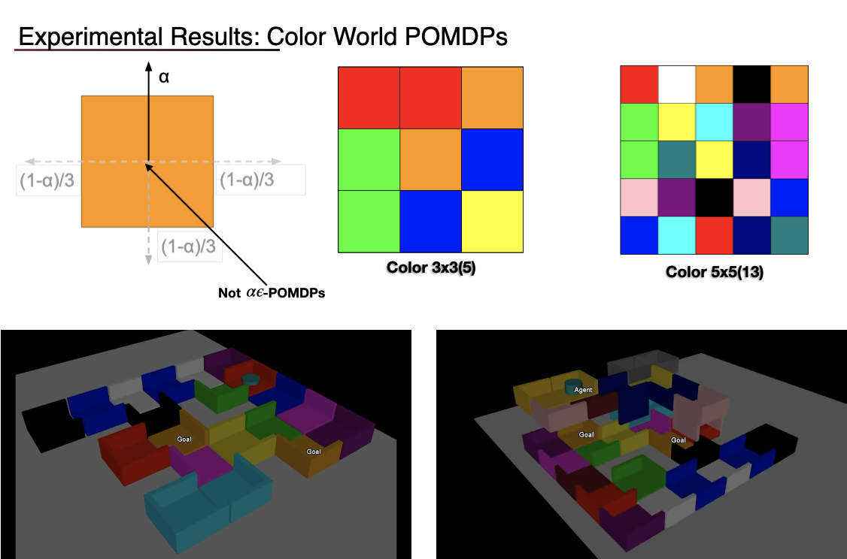
Surprise-Based Learning POMDP - the color world environment

Slide 40
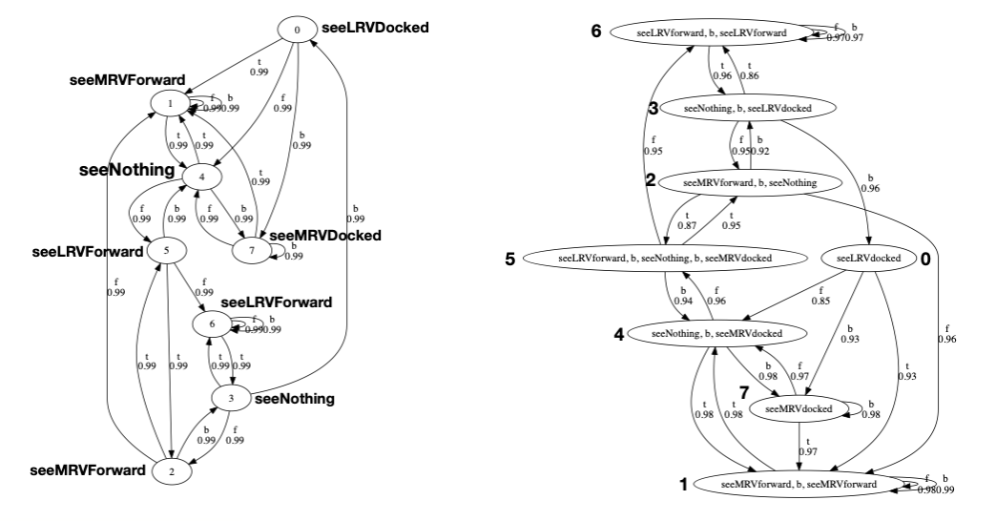
Surprise-Based Learning POMDP (shuttle environment)

Slide 41
Summary of SBL Capabilities (so far)
Structure Learning
Surprise-Based Learning for Developmental Robotics, LAB-RS 2008
+Discover the number of states
+Scalable/not over fitting in structured environments
+Few training examples produce a good model
+Learns generic models that can solve specific goals
+Temporal modeling with predictive capability
Learning from uninterpreted sensors and actions
The Surprise-Based Learning Algorithm, ISI Technical Report 2008
+Preprocessing not required
+Can use preprocessed data
+Discretizes continuous data
+Identifies useful sensors and ignores irrelevant sensors
Detecting and adapting to unpredicted changes
Autonomous Adaptation to Simultaneous Unexpected Changes in Modular Robots, IROS 2011 Workshop
Surprise-based developmental learning and experimental results on robots, ICDL 2009
+Adapt to action changes
+Adapt to sensor changes
+Adapt to environmental changes
+Adapt to goal changes
+Adapt to simultaneous action, sensor, environment & goal changes
+Repairs model faster than rebuilding it from scratch
Detecting and reasoning with interference
Autonomous Surveillance Tolerant to Interference, TAROS 2012
+Detects noise
+Detects and fills gaps
+Quantify similarity between learned model and observed data
+Reason with data of variable durations

Slide 42
Future Work for SBL
Explicitly tolerate interference during model learning
Probabilistic rules can accommodate noise
Keep copies of the original rules during splitting and refinement
Planner must consider these probabilities to remove invalid plans
Faster model convergence
Incorporate knowledge that some actions are reversible
Hypothesize and test
Create abstracted prediction rules during rule creation
Identify hidden states with Local Distinguishing Experiments [2018]
Utilize multiple SBL learners (distributed or nested hierarchy)
Improve scalability in the number of sensors
Limit search space of surprise analysis through goal directed learning
Reduce planning overheads
Generate policies with the prediction model for common goals

Slide 43
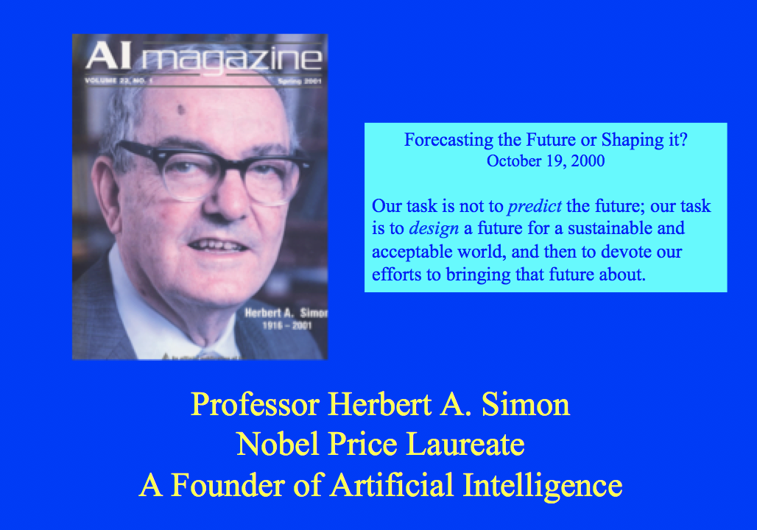
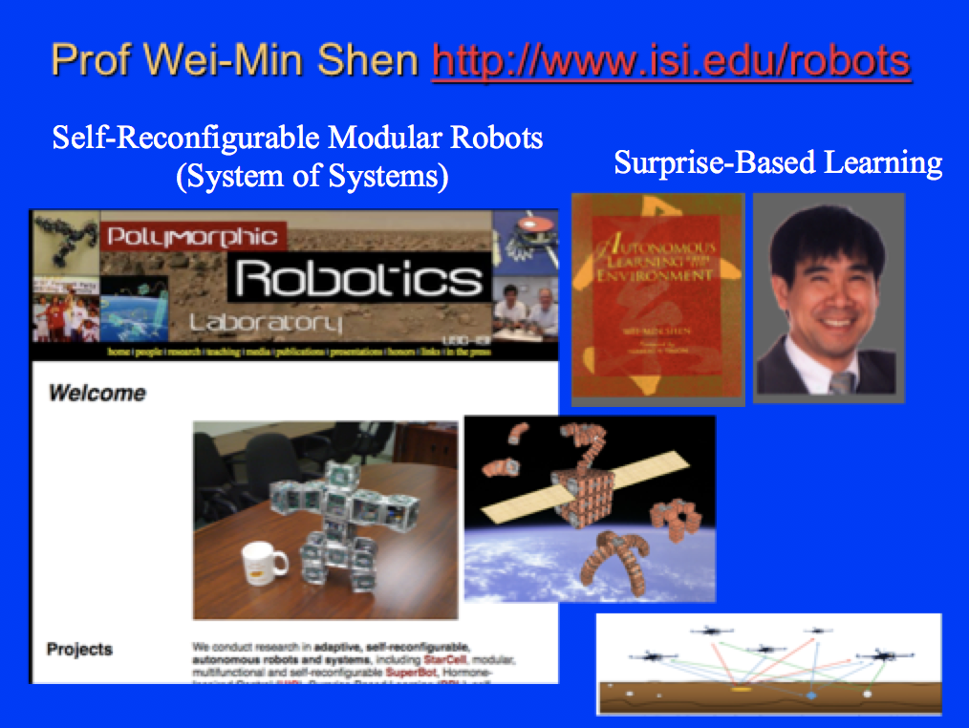
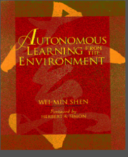
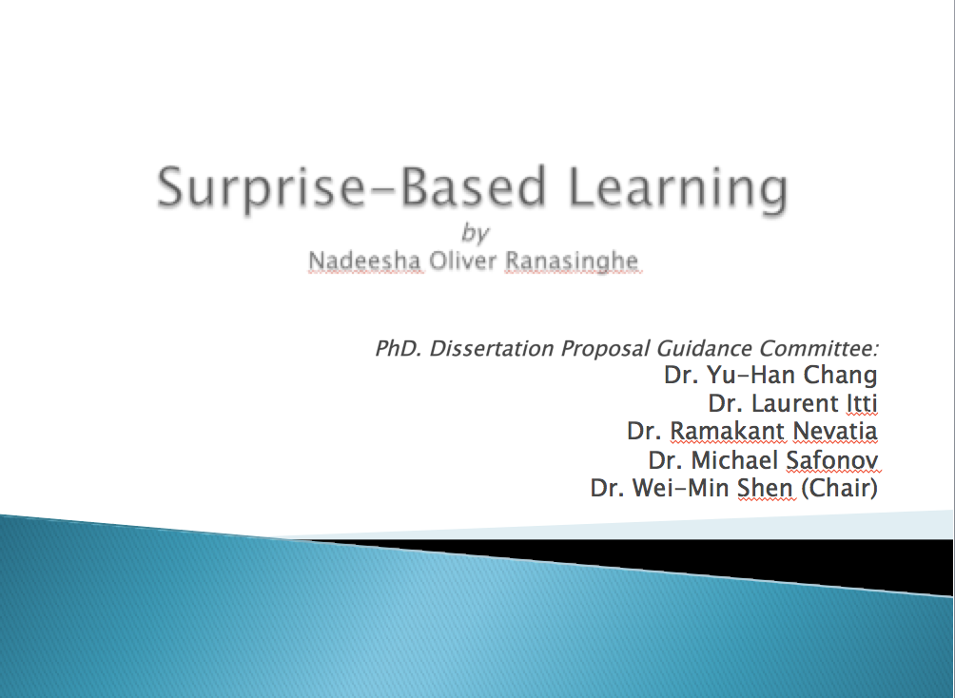
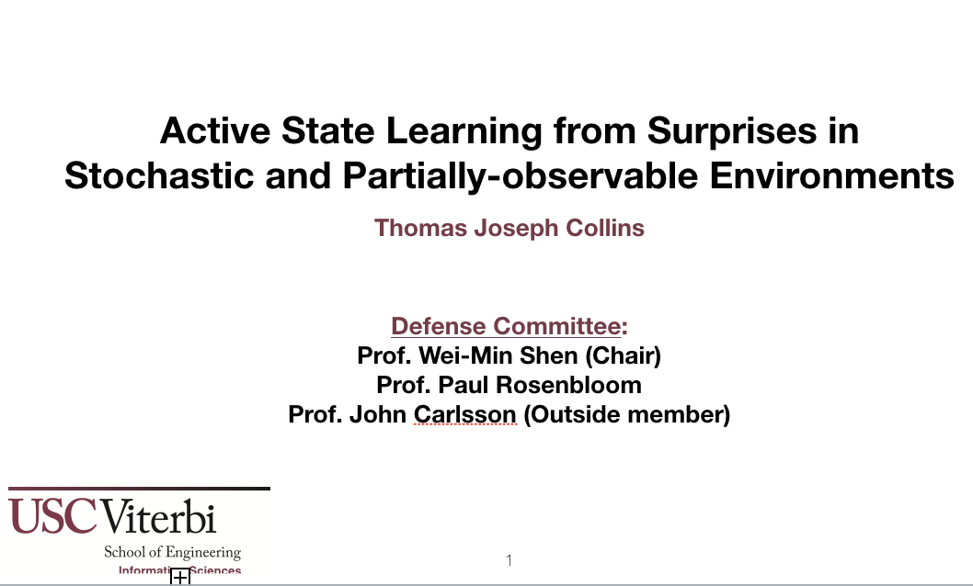
Surprise-Based Learning
Herbert A. Simon (1916-2001)
Nobel Prize Winner (AI, Machine Discovery)
Wei-Min Shen (1983 – now)
Autonomous Learning from the Environment
Discovery of hidden variables
Nadeesha Ranasinghe (2005 – 2011)
Learn and predict unexpected changes
Thomas J. Collins (2013 – 2018)
Discovery of hidden/latent structures

